Slide 1
Getting ready for rotational motion

Slide 2
What is torque

Slide 3
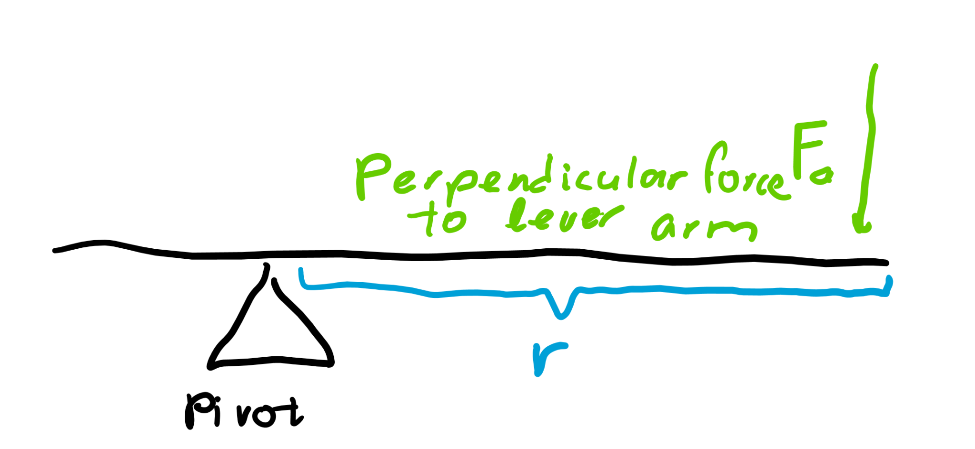
Torque
If you apply a force on a pivot, it will spin.
It’s obvious that increasing the force will increase the amount it will spin.
However, increasing the length of the lever also increases spin.
Torque, Τ, is the combination of the two effects.

Slide 4
Units
As torque is radius x force, the units are mN.
Work was force * distance, which has units Nm, or Joules.
The reason it’s mN for torque is to differentiate it from work.

Slide 5
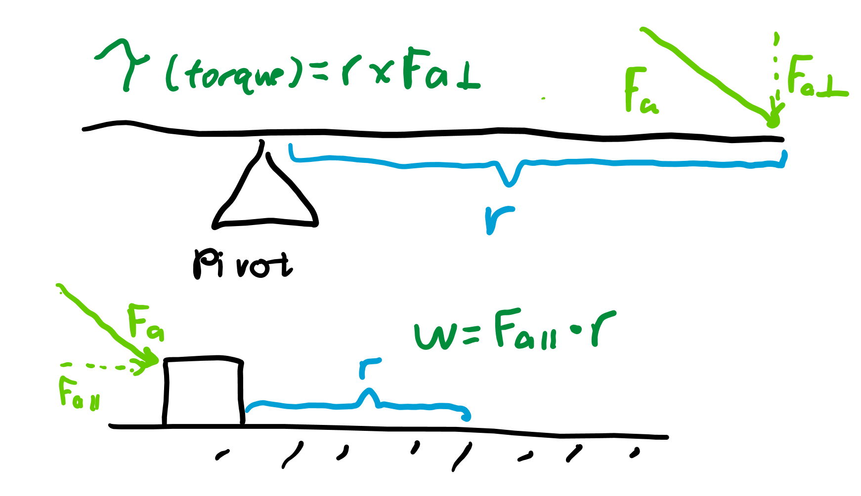
Work vs torque
Work is force times the distance in which it’s applied (only the force parallel to the distance the force is applied is counted).
Torque is force applied perpendicular to a lever arm, so only the force perpendicular to the distance of the lever is counted.

Slide 6
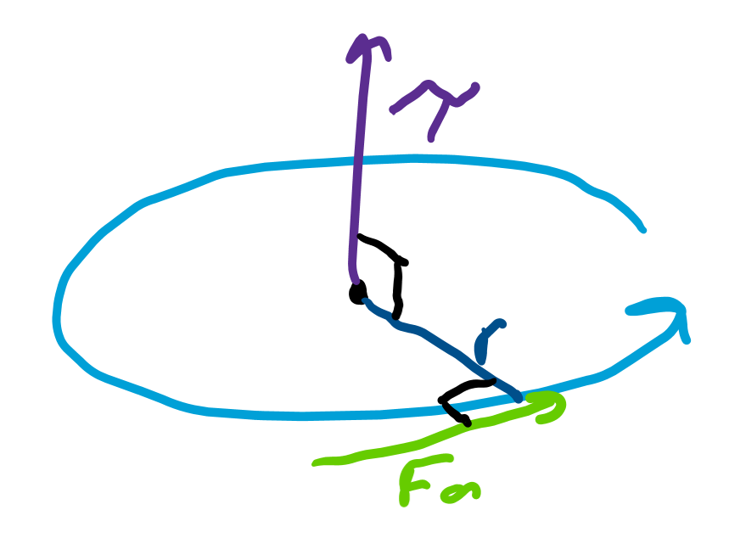
Direction of torque
Torque is “rotational” force, or how much you are attempting to rotate an object either counterclockwise or clockwise.
Drawing a circular arrow to represent torque is hard, so the convention is to draw the direction of torque perpendicular to the plane of rotation.

Slide 7
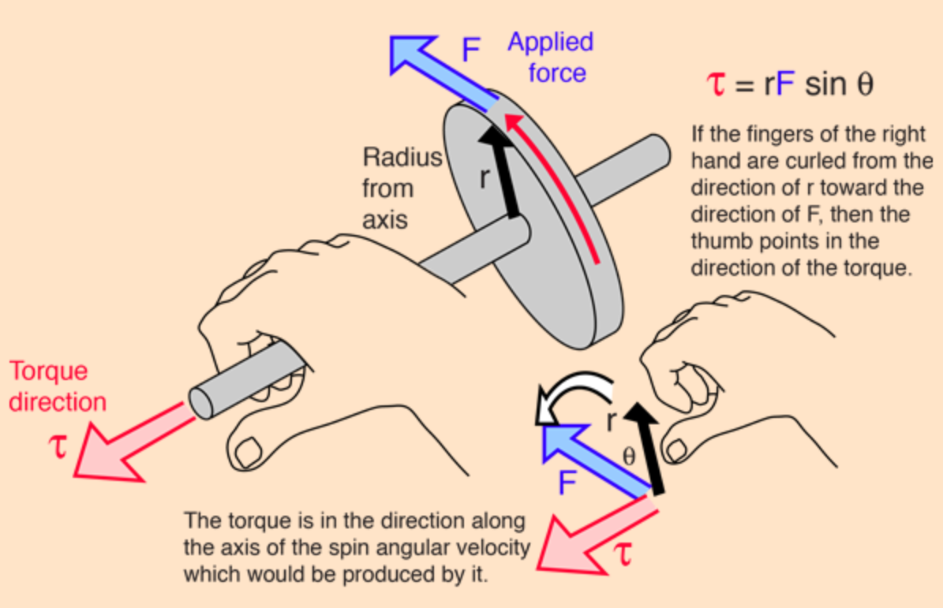
Right hand rule
There are two directions perpendicular to the plane of rotation.
To find the proper direction of torque, you can curl your fingers in the direction of rotation and the direction your thumb points is the direction of torque.

Slide 8
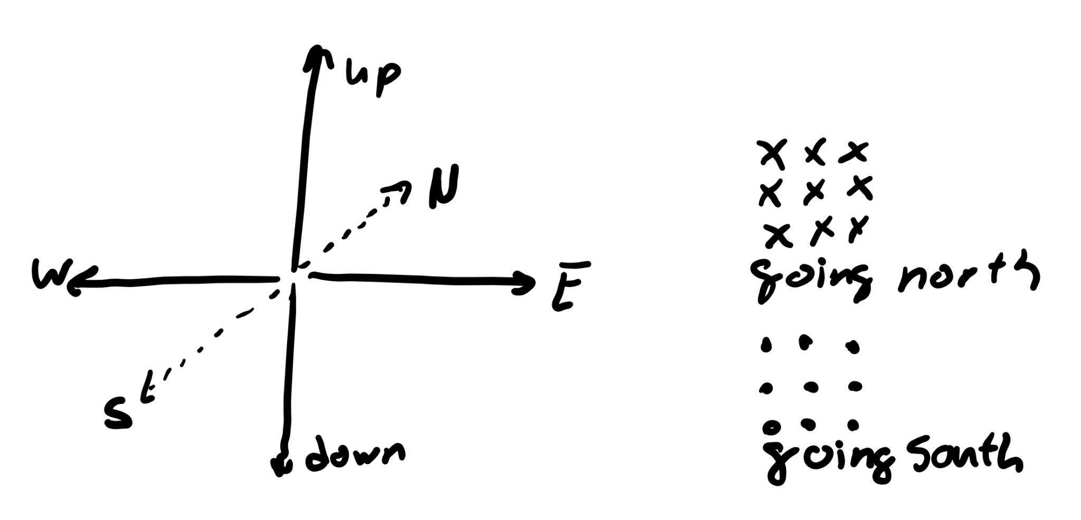
Physics directions
We can use symbols to denote things going into and out of the page.
x represents a vector going in the page and . represents a vector coming out.
North is in the page, South is out, East is to the right, West is to the left, up is up, and down is down. These are the six directions in physics.

Slide 9
Center of mass

Slide 10
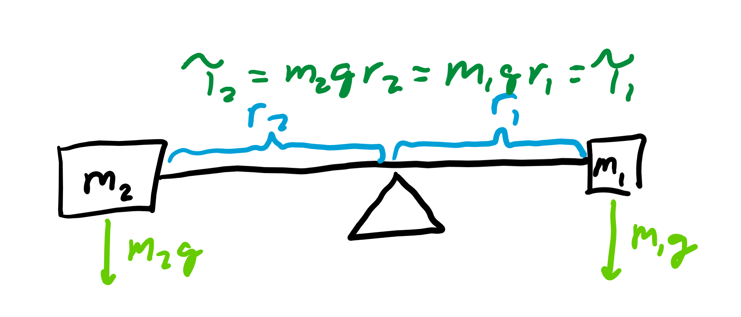
Balancing torque
Let’s say we want to put a pivot under an object so the object is perfectly balanced.
Weight at each point on the object will provide the perpendicular forces for this lever arm.
If the torques on both sides cancel each other out, the object will be balanced.

Slide 11
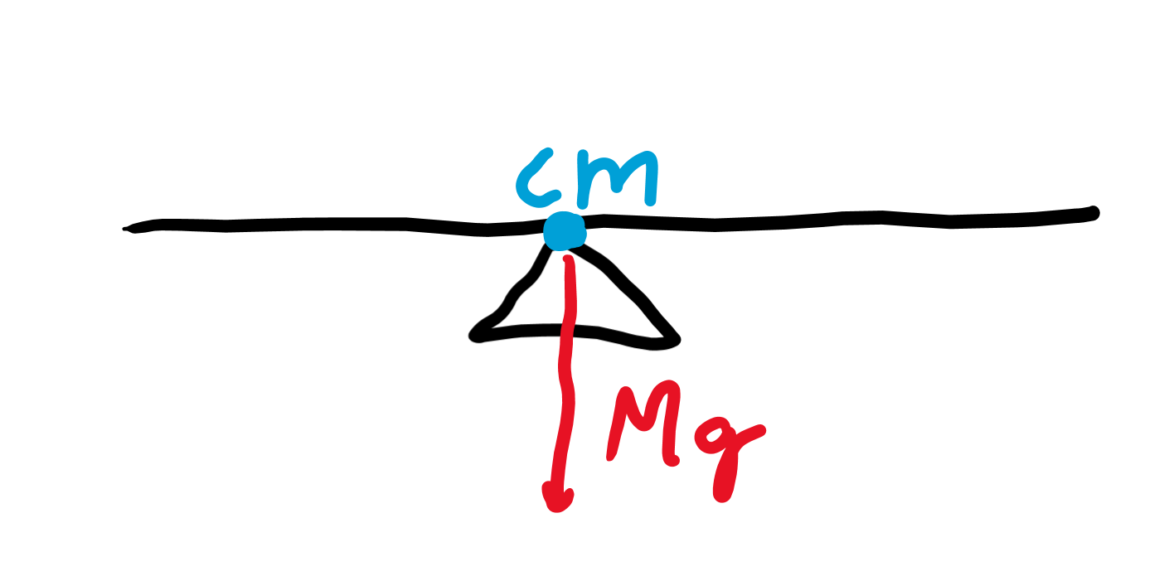
What is center of mass (cm)
Where does gravity act?
If the pivot is balanced right below the center of mass, the weight acts on that center and pulls down on the pivot.
We would expect the object not to rotate either, which is what happened when torques were balanced.

Slide 12
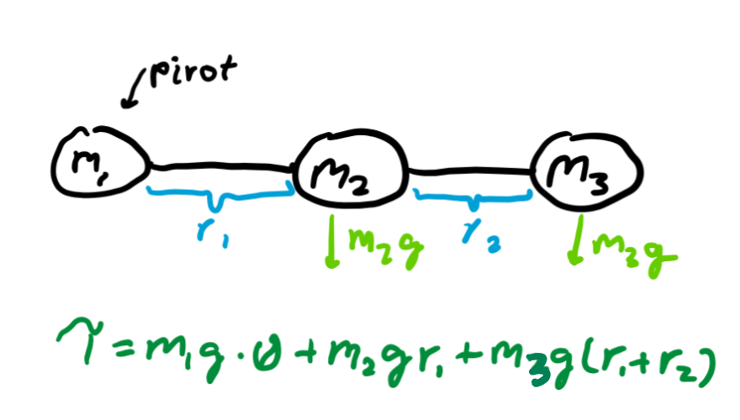
Point masses
These are discrete points of mass where you assume the rod connecting these masses is massless.
We can calculate the torque each point mass applies with respect to one side of the system as a pivot.

Slide 13
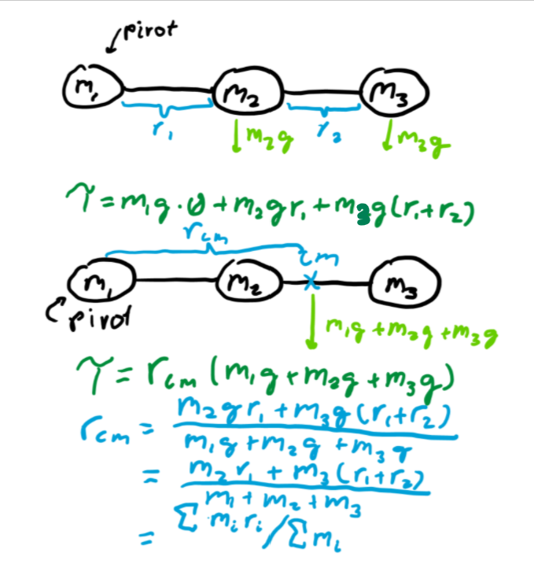
Finding discrete center of mass
We know weight acts on the center of mass, so the torque provided from the total weight of the system times the distance a side is from the center of mass must equal the sum of the individual torques applied by the weight of each point mass.

Slide 14
Rearranging to find center of mass
Let’s make the leftmost side of our object the pivot.
Let the distance to the center of mass be x and the total mass of the system be M.
Let the point masses be m_{i} and distances from the left be x_{i}. Then we know that xMg=Σx_{i}m_{i}g. Thus, x = (Σx_{i}m_{i})/M.

Slide 15
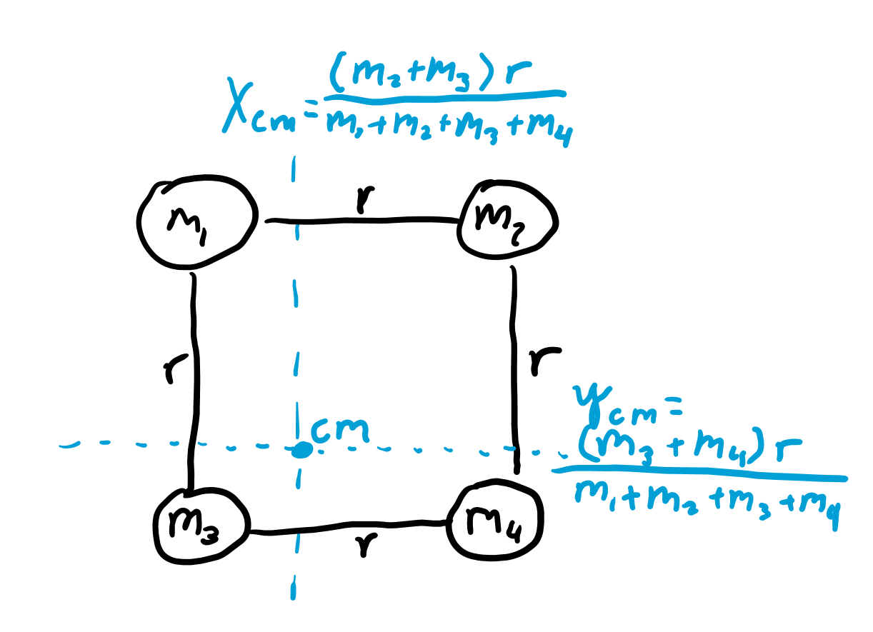
Two-dimensional center of mass
Instead of a point pivot, let’s find a line of pivot.
We do this by squeezing the system down into a line, and then finding the pivot point.
This pivot point translates to a line of pivot when we unsqueeze the system.
Where two distinct lines of pivot intersect is the center of mass.

Slide 16
Multi-dimensional center of mass
If we compress each axis into a line, we can find a pivot line, plane, etc. which varies by dimension.
If we find where a distinct number n of these pivot objects intersect where n is the number of dimensions we’re working with, we find the center of mass.

Slide 17
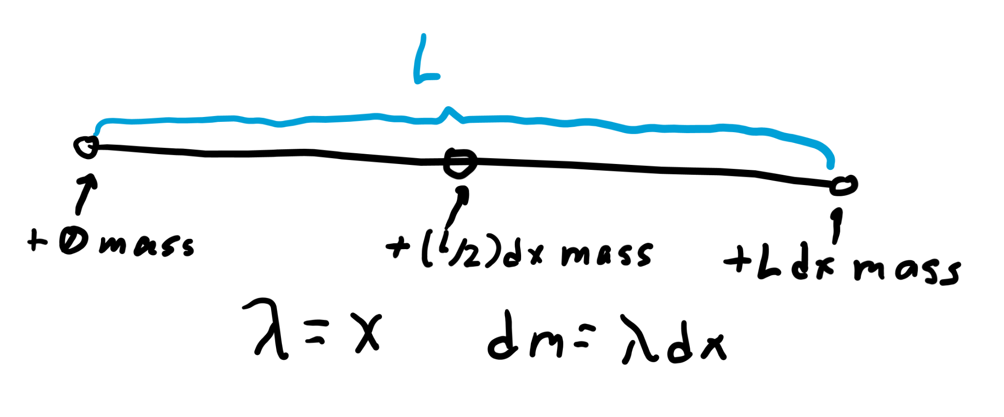
Linear density
However, most masses are continuous, so the mass on an object may follow a formula.
Let’s consider a 1d rod.
The rod may get heavier as you go, so the linear density on the rod may follow the function λ=x where x is the distance away from the left side of the rod.

Slide 18
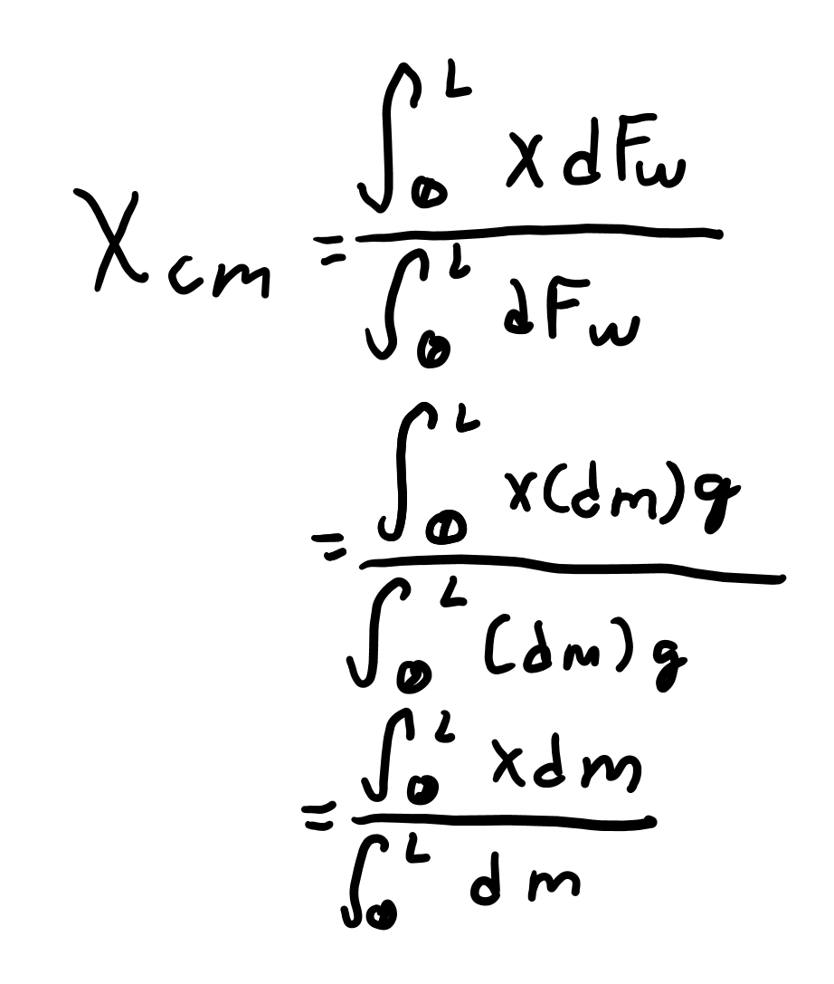
Setting up our equation
We know that x_{cm} = sum of torques / total mass of system.
As an integral this can be written as x_{cm}= ∫xdm/∫dm = ∫xdm/m.
Each integral is a definite integral from 0 to L where L is the length of the system, so if F(x) is the function representing the indefinite integral, the definite integral is F(L) - F(0).

Slide 19
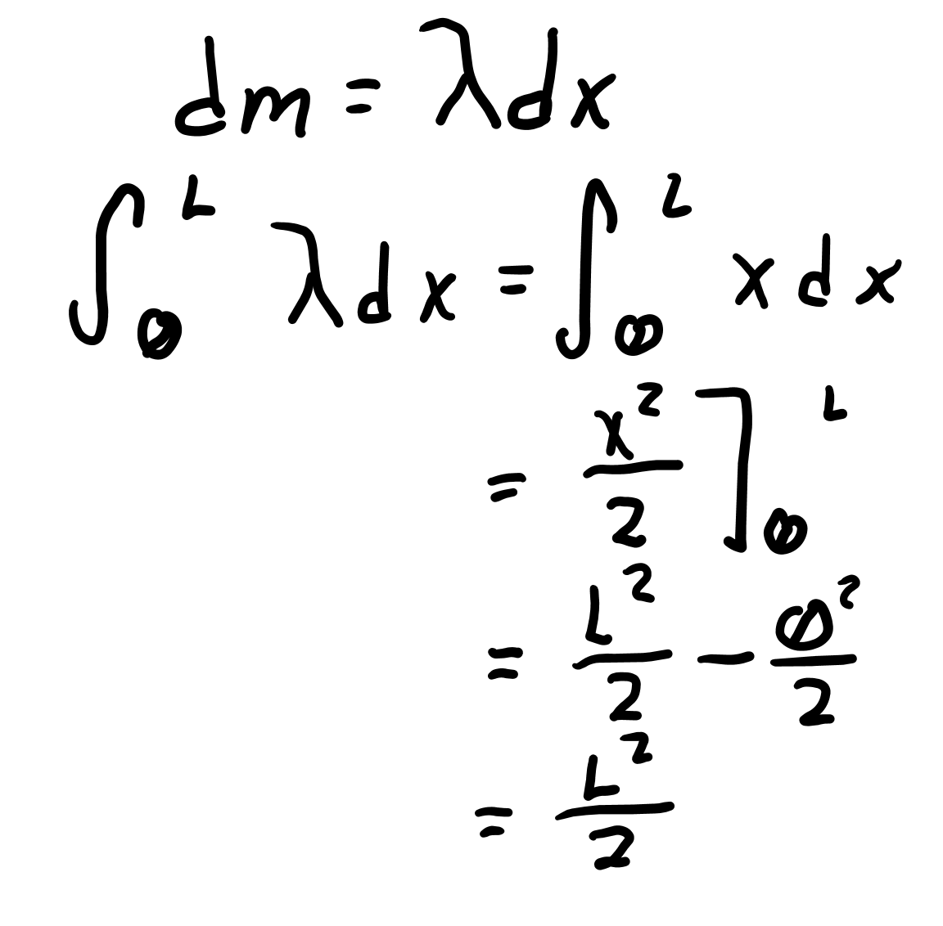
Finding m
To find the mass, you just integrate linear density across the distance of the rod (from 0 to L) with respect to distance.
In other words, dm = λdx, so integrating both sides will give m = ∫λdx where you integrate from 0 to L.
In our case, m = L²/2-0²/2 = L²/2.

Slide 20
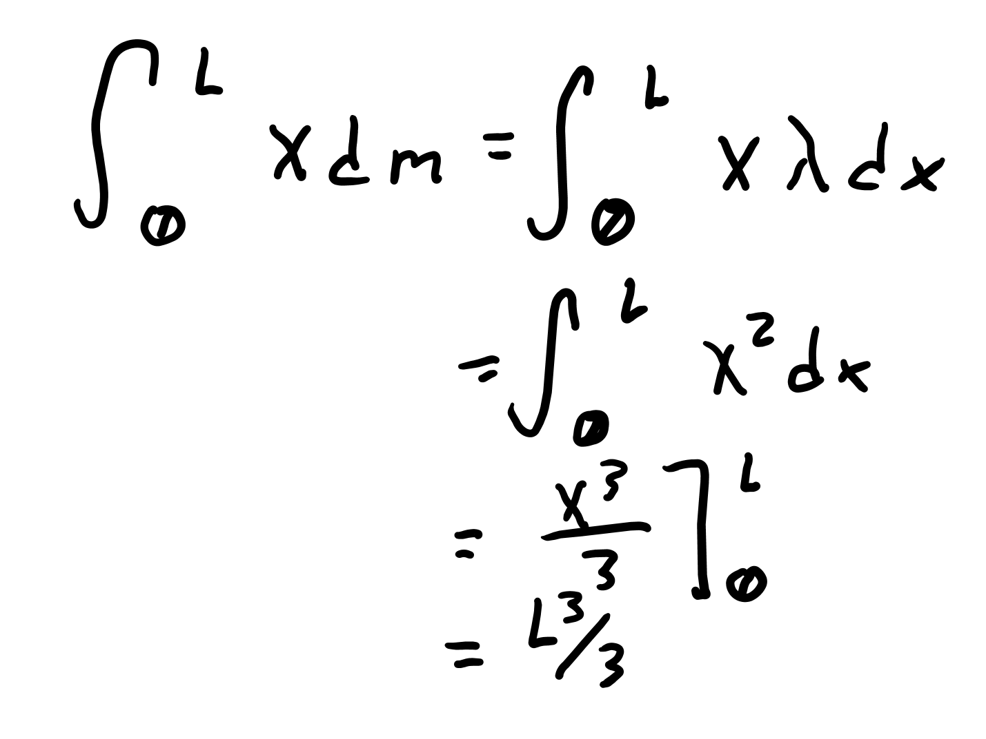
Finding ∫xdm
We want to find ∫xdm, knowing dm = λdx.
Thus, = ∫xdm = ∫xλdx.
In our case, this is an integral from 0 to L of ∫x²dx = L³/3-0³/3 = L³/3.

Slide 21
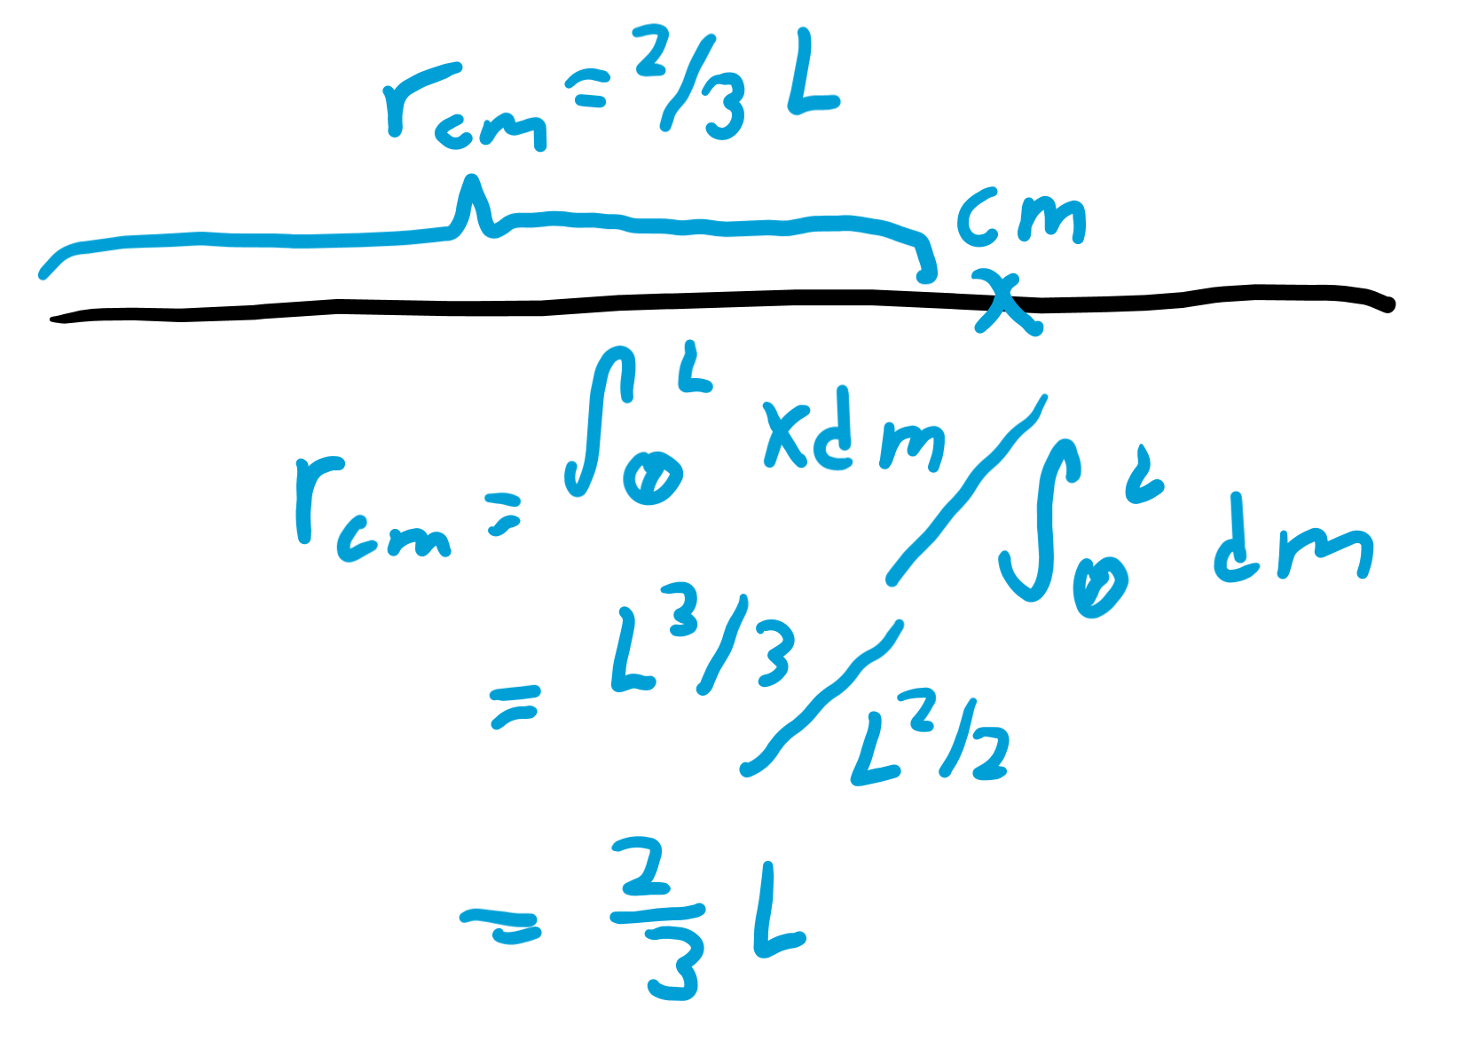
Putting it together
For our problem, we now plug in each thing we found to the equation to find that the distance the center of mass is away from the left side of the rod is L³/3 / (L²/2) = 2L/3, or ⅔ of the way from the left side of the rod.

Slide 22
Power

Slide 23
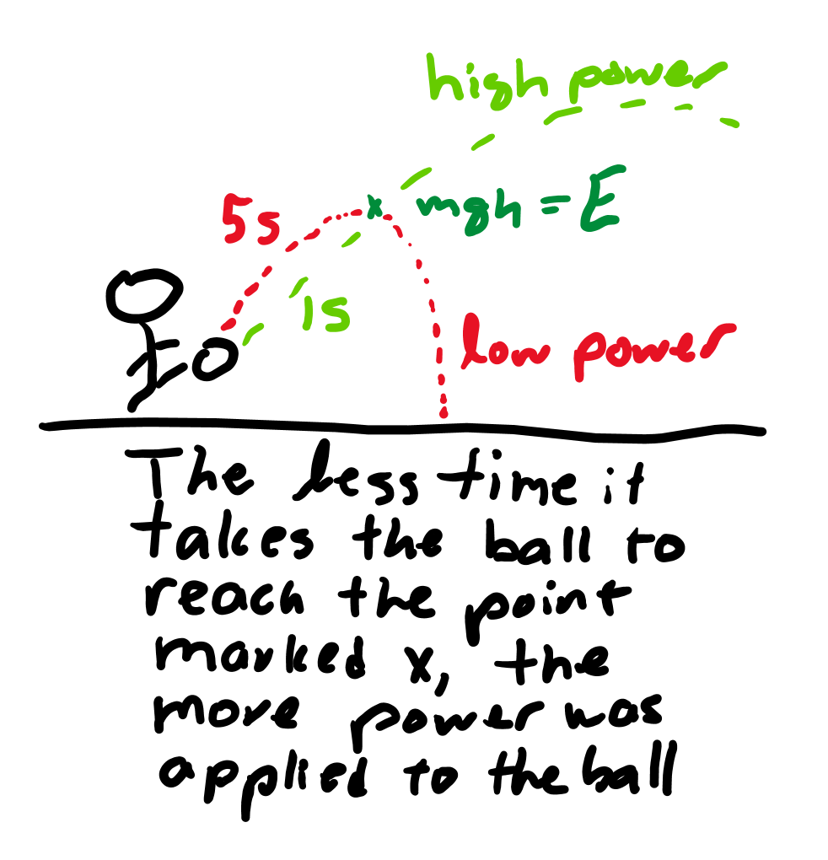
Concept
Power is energy over time.
As a derivative, this is the derivative of energy with respect to time.
If energy was represented as a function E = ½ t², then power would be t at any instant.

Slide 24
Equations
P (power) is measured in Watts, or Joules/second.
P = E/t = Fd/t = Fv.
Thus, another way to calculate power is to integrate the force function with respect to velocity.
For a constant force this is equivalent to multiplying force and velocity.

